Slide 1

SMART INDUSTRY SAFETY SYSTEM
PRAVINESH H (210701194)
SELESTIN S (210701236)

Slide 2


INTRODUCTION
The IoT-Based Smart Industry Safety System aims to improve safety in factories and industrial settings using IoT technology. By using smart sensors and a connected mobile app, the system allows for real-time monitoring, instant alerts, and automatic responses to dangerous situations. This solution makes workplaces safer, reduces the risk of accidents, and helps meet safety standards. It also supports predictive maintenance and better decision-making, which helps to reduce downtime and save costs. Overall, this smart safety system provides a smarter and more efficient way to manage industrial safety.

Slide 3


PROBLEM STATEMENT
In many factories, safety is a big concern because traditional safety systems can't always monitor and respond to dangers quickly. This can lead to serious accidents and injuries. Managing safety inefficiently also means more downtime and higher costs. To solve these problems, we need an IoT-based solution that can monitor the factory in real-time, send instant alerts, and respond automatically to hazards. This system will make workplaces safer, ensure they meet safety standards, and reduce downtime and costs.

Slide 4

OBJECTIVE
01
Monitor and alert about hazards in real-time to prevent accidents.
Automatically meet and track safety standards
02
Reduce expenses by improving safety and efficiency.
03

Slide 5

COMPONENTS USED
Esp 32 microcontroller(Wifi module)
MQ4 Gas sensor
DHT11 Temperature sensor
Jumper wires
Breadboard

Slide 6
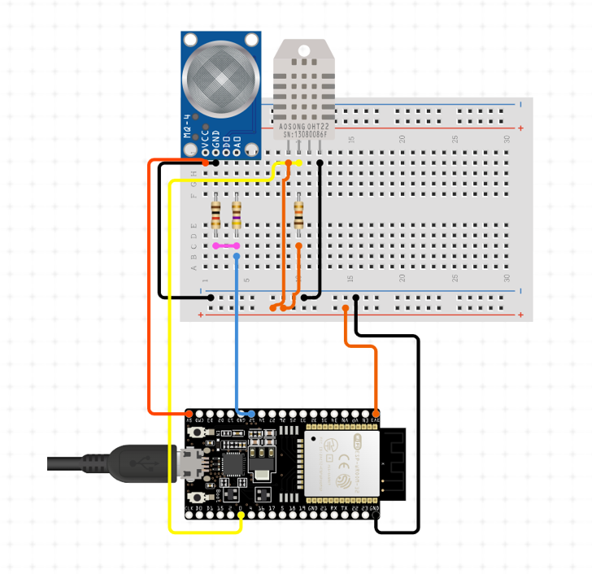

CIRCUIT DIAGRAM

Slide 7

OUTPUT
ESP32

Slide 8
RESULT
The system successfully detected simulated scenarios such as gas leaks, fires, extreme temperatures, and unauthorized intrusions with a high degree of accuracy and reliability. During testing, the system exhibited rapid response times upon detection of hazards, triggering alarms and activating safety protocols within milliseconds. Furthermore, the system's multi-channel alerting mechanism proved invaluable in ensuring timely communication with relevant personnel. Alerts delivered via SMS, email, and mobile app notifications enabled swift response coordination and decision-making, enhancing overall safety outcomes. The user-friendly interface provided by the web dashboard and mobile application facilitated easy monitoring and configuration of the system. Real-time data logs and analytics offered valuable insights into environmental conditions, aiding in proactive maintenance and risk management strategies

Slide 9
CONCLUSION
In conclusion, the Industry Safety System represents a critical advancement in safety technology, offering comprehensive monitoring and rapid response capabilities to mitigate potential dangers in diverse environments. By leveraging a network of sensors and a sophisticated microcontroller, the system can swiftly identify hazards such as gas leaks, fires, extreme temperatures, and unauthorized intrusions. Through immediate activation of alarms and predefined safety protocols, it facilitates swift and effective responses to mitigate risks and minimize potential damage. Furthermore, the system's user-friendly interface enables seamless monitoring and configuration, while data logs and real-time analytics provide valuable insights for preventive maintenance and risk assessment. Its reliability, efficiency, and ability to provide early warnings make it an indispensable tool for safeguarding against potential hazards.

Slide 10
FUTURE SCOPE
Future work for the Hazard Detection System includes integrating advanced artificial intelligence algorithms for more accurate hazard identification and predictive analytics. Enhanced sensor technologies, such as hyperspectral imaging and chemical sensing, can broaden the system's capabilities to detect a wider range of hazards. Implementing a decentralized architecture with blockchain technology could enhance data security and facilitate interoperability between different sensor networks. Additionally, exploring the use of drones and robotics for remote hazard assessment and response could further improve the system's effectiveness in challenging environments. Continued research into energy-efficient sensors and communication protocols will also be crucial for scalability and sustainability.

Slide 11
THANK
YOU

